Slide 1
How to build a brain from scratch
Lecture 3:
Supervised learning

Slide 2

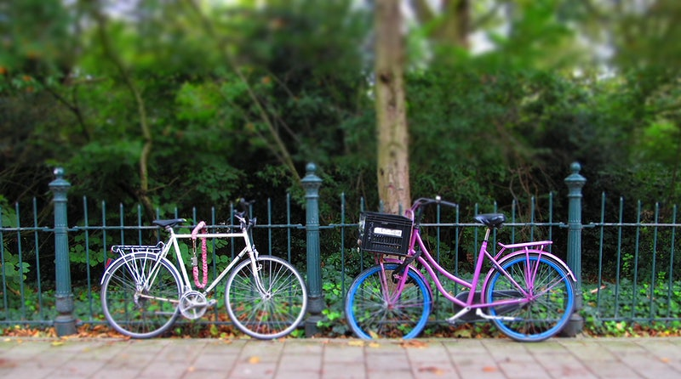

The goals of perception
tree
Computing affordances (reinforcement learning)
Abstracting over similarities (generative modelling)
Inferring names and properties (supervised learning)
Notes:
In my talk I’m going to describe a systematic investigation of human transfer. I’m going to show that people can exhibit quite striking zeros-shot compositional generalization.
I use the term nontrivial to describe this generalization. By that I mean that it cannot be chalked up to a demand characteristic of the task and that neural networks do not show this generalization.
I’m going to describe two different manipulations of the training curriculum that encourage or discourage generalization.
I’m going to show that a simple computational idea can be incorporated into a neural network to make them transfer like humans in the experimental setting we study
And finally, I’m going to show you something else interesting that humans do.

Slide 3
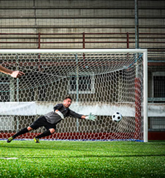
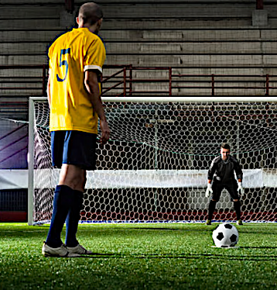
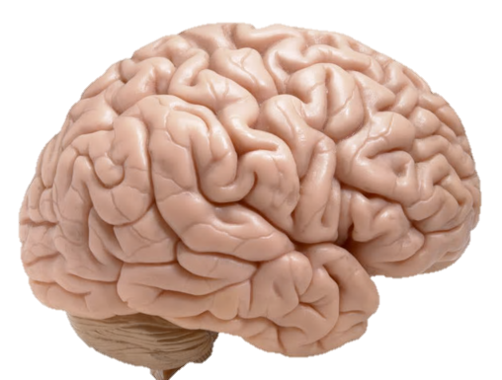
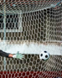
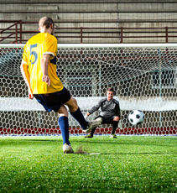
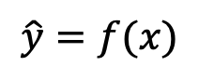
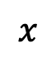
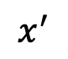
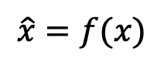
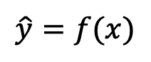
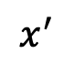
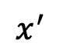
Mapping functions
$$x^{′}$$
$$\hat{y}=f(x)$$
$$x$$
$$x^{′}$$
$$x^{′}$$
A football player is about to take a penalty. He is wearing a yellow shirt.
$$\hat{x}=f(x)$$
$$\hat{y}=f(x)$$
Notes:
Let’s begin with a question. What is really special about human intelligence? What makes us distinctive from that of other highly intelligent species, such as monkeys and birds?
Well, there are lots of anwers to this question, but in this talk I’d like to focus on one of them.

Slide 4

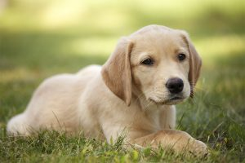
Object recognition / labelling
This is a cat
This is a dog
But how does the brain work that out?
The challenge of vision is the infinite variety of the universe. Every image (state) that is incident on the retina is at least partly unique!
Notes:
Let’s begin with a question. What is really special about human intelligence? What makes us distinctive from that of other highly intelligent species, such as monkeys and birds?
Well, there are lots of anwers to this question, but in this talk I’d like to focus on one of them.

Slide 5
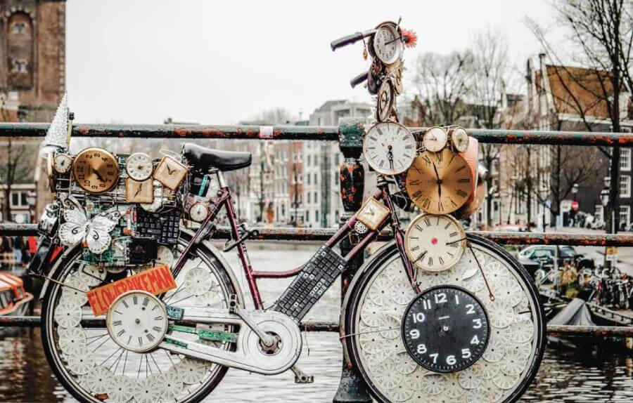
Vision is hard
bicycle, clock or sculpture?
Object labels can be ambiguous
Notes:
In my talk I’m going to describe a systematic investigation of human transfer. I’m going to show that people can exhibit quite striking zeros-shot compositional generalization.
I use the term nontrivial to describe this generalization. By that I mean that it cannot be chalked up to a demand characteristic of the task and that neural networks do not show this generalization.
I’m going to describe two different manipulations of the training curriculum that encourage or discourage generalization.
I’m going to show that a simple computational idea can be incorporated into a neural network to make them transfer like humans in the experimental setting we study
And finally, I’m going to show you something else interesting that humans do.

Slide 6

Vision is hard
Objects are often seen from unusual views
Notes:
In my talk I’m going to describe a systematic investigation of human transfer. I’m going to show that people can exhibit quite striking zeros-shot compositional generalization.
I use the term nontrivial to describe this generalization. By that I mean that it cannot be chalked up to a demand characteristic of the task and that neural networks do not show this generalization.
I’m going to describe two different manipulations of the training curriculum that encourage or discourage generalization.
I’m going to show that a simple computational idea can be incorporated into a neural network to make them transfer like humans in the experimental setting we study
And finally, I’m going to show you something else interesting that humans do.

Slide 7
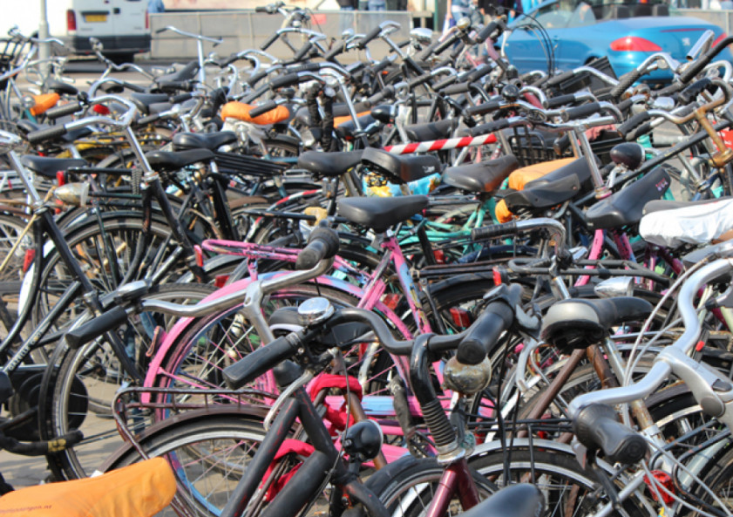
Vision is hard
Scenes are cluttered
Notes:
In my talk I’m going to describe a systematic investigation of human transfer. I’m going to show that people can exhibit quite striking zeros-shot compositional generalization.
I use the term nontrivial to describe this generalization. By that I mean that it cannot be chalked up to a demand characteristic of the task and that neural networks do not show this generalization.
I’m going to describe two different manipulations of the training curriculum that encourage or discourage generalization.
I’m going to show that a simple computational idea can be incorporated into a neural network to make them transfer like humans in the experimental setting we study
And finally, I’m going to show you something else interesting that humans do.

Slide 8
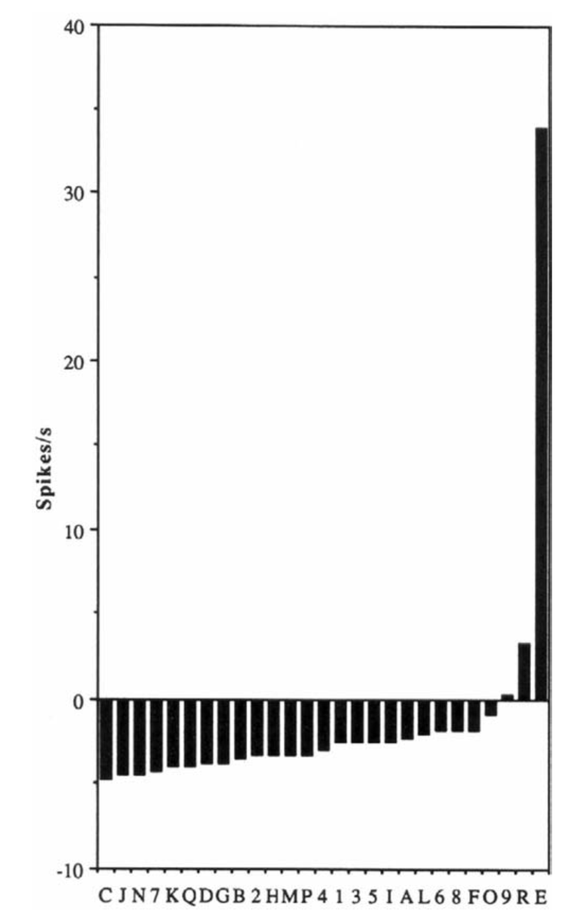
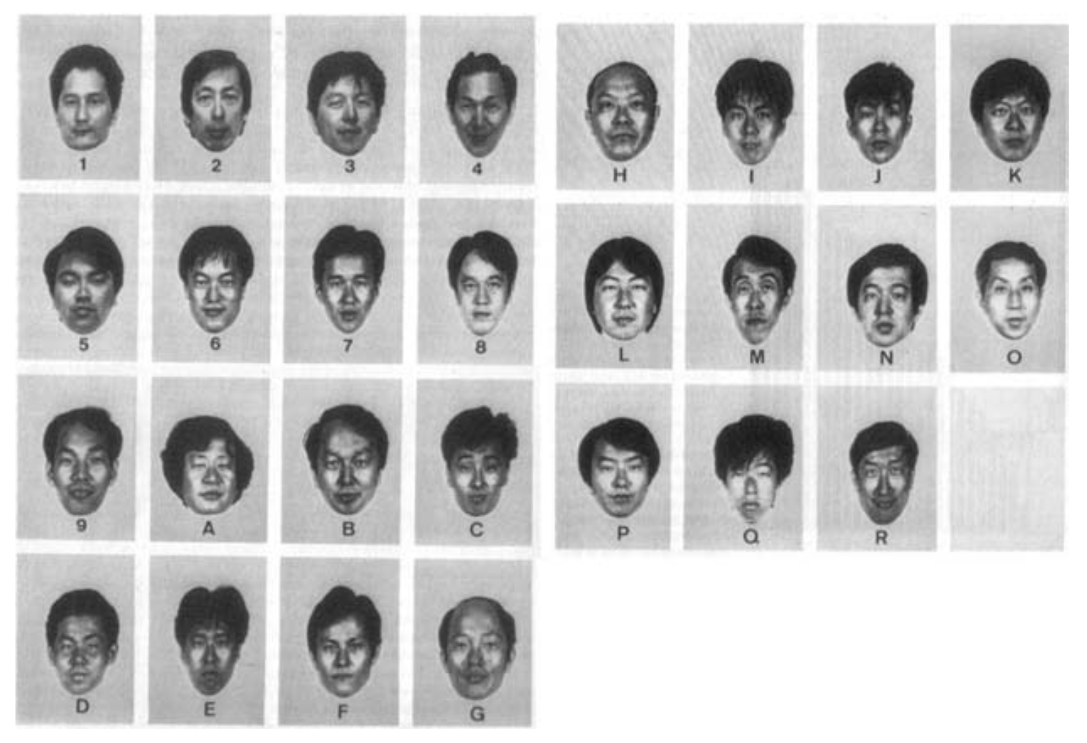
Object recognition
View dating back to the 1960s: sparse coding of shapes and objects in extrastriate visual cortex
i.e. there are “grandmother cells” that code for a specific object identity
However, most cortical coding is distributed (see Bowers, 2009 for a useful discussion)
Mr. E
Young & Yamane 1992
Notes:
Let’s begin with a question. What is really special about human intelligence? What makes us distinctive from that of other highly intelligent species, such as monkeys and birds?
Well, there are lots of anwers to this question, but in this talk I’d like to focus on one of them.

Slide 9
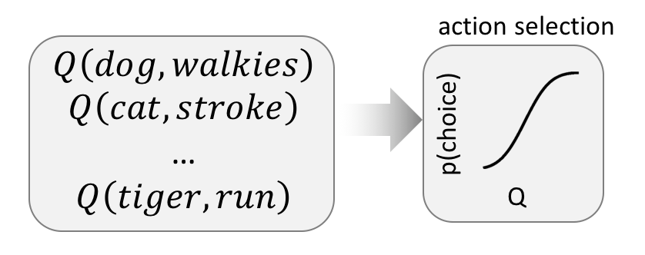
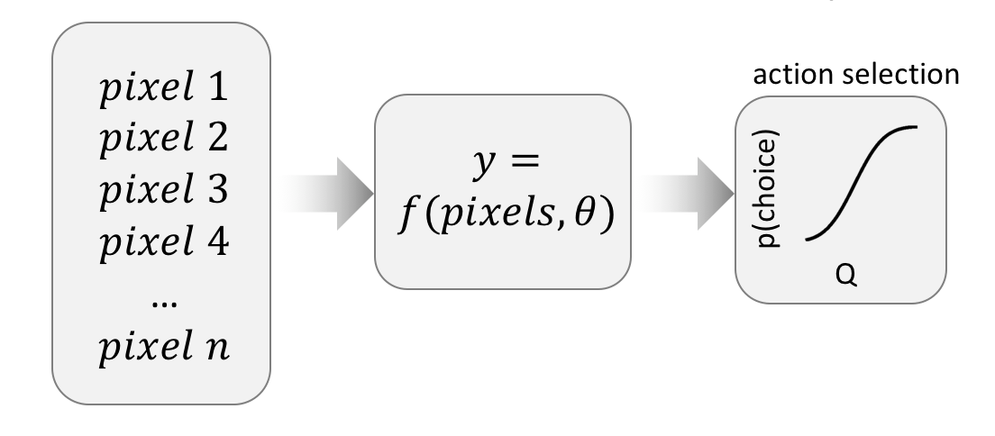
Parametric and nonparametric models
Nonparametric models are like lists or lookup tables.
The model size grows with the number of possible inputs
Parametric models take an input of fixed size and transform it via a parameterized function
Model size remains fixed
To deal with the infinite variety of the sensory world, we need a parametric model
Notes:
Let’s begin with a question. What is really special about human intelligence? What makes us distinctive from that of other highly intelligent species, such as monkeys and birds?
Well, there are lots of anwers to this question, but in this talk I’d like to focus on one of them.

Slide 10

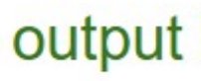


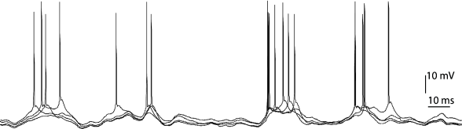
What are visual representations?
weights
weights
weights
each layer can be thought of as decoding the information from previous layers
When we measure tuning properties, we are decoding the information that is sent to a neuron, which in turn depends on its connections (input weights)
So a different way to understand a neural system is: what is the principle by which the connections are learned?
Notes:
Let’s begin with a question. What is really special about human intelligence? What makes us distinctive from that of other highly intelligent species, such as monkeys and birds?
Well, there are lots of anwers to this question, but in this talk I’d like to focus on one of them.

Slide 11
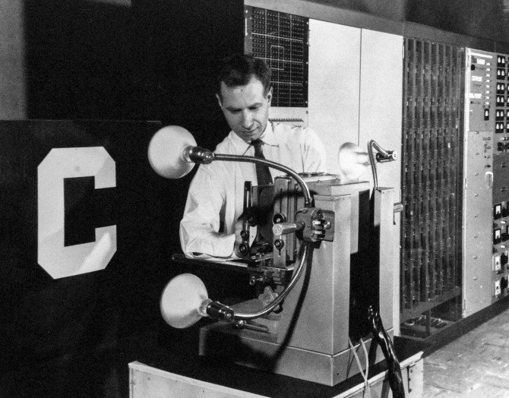
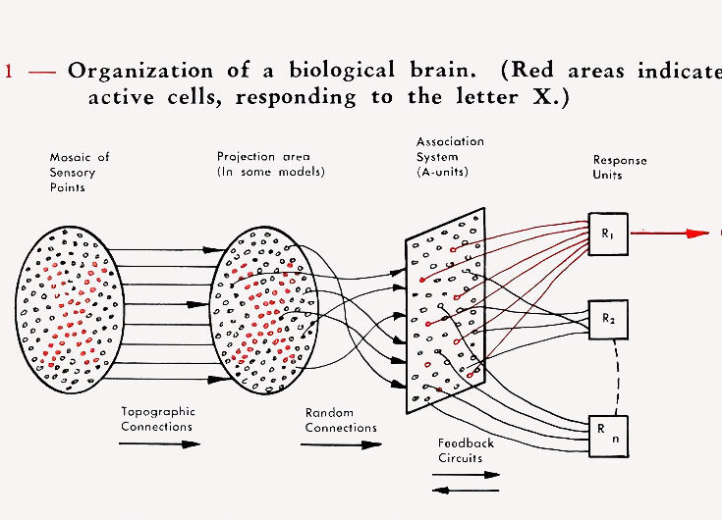
Neural networks
Frank Rosenblatt
Rosenblatt’s Perceptron was the first neural network to learn weights that transform inputs into outputs
In a neural network, memory = computation

Slide 12


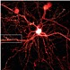
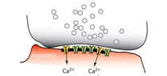
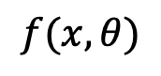
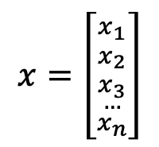
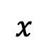
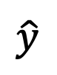
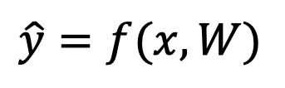
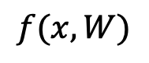
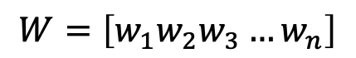
Neural networks
$$\hat{y}=f(x,W)$$
$$x$$
$$f(x,θ)$$
$$\hat{y}$$
$$f(x,W)$$
“cat”
$$x=\left[{{x_{1} \atop x_{2}} \atop {\begin{aligned}x_{3} \\ …\end{aligned} \atop x_{n}}}\right]$$
parameters
$$W=\left[w_{1}w_{2}w_{3}…w_{n}\right]$$
Notes:
Let’s begin with a question. What is really special about human intelligence? What makes us distinctive from that of other highly intelligent species, such as monkeys and birds?
Well, there are lots of anwers to this question, but in this talk I’d like to focus on one of them.

Slide 13

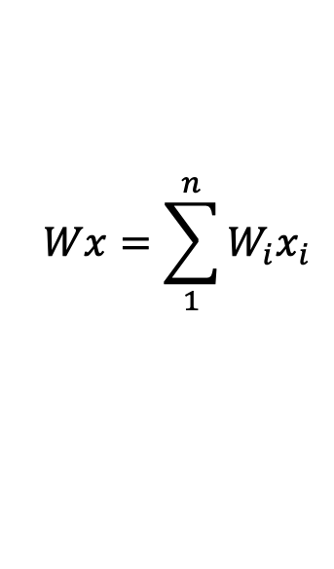
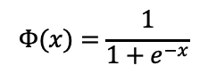
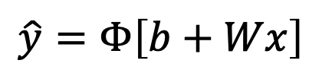
Neural networks
$$\hat{y}=f(x,W)$$
$$Φ(x)=\frac{1}{1+e^{−x}}$$
$$Wx=\sum_{1}^{n}{W_{i}x_{i}}$$
$$x$$
sigmoid
$$f(x,θ)$$
$$\hat{y}=Φ\left[b+Wx\right]$$
$$f(x,W)$$
“cat”
$$x=\left[{{x_{1} \atop x_{2}} \atop {\begin{aligned}x_{3} \\ …\end{aligned} \atop x_{n}}}\right]$$
parameters
$$W=\left[w_{1}w_{2}w_{3}…w_{n}\right]$$
Notes:
Let’s begin with a question. What is really special about human intelligence? What makes us distinctive from that of other highly intelligent species, such as monkeys and birds?
Well, there are lots of anwers to this question, but in this talk I’d like to focus on one of them.

Slide 14
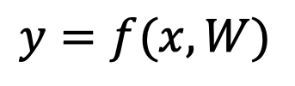
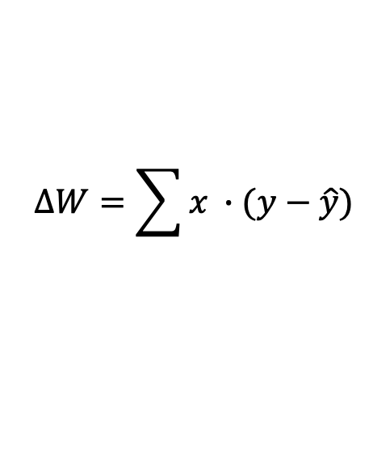
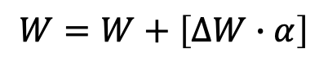
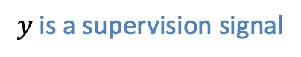
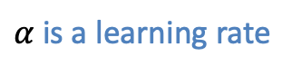
Neural networks
$$y=f(x,W)$$
$$Φ(x)=\frac{1}{1+e^{−x}}$$
$$Wx=\sum_{1}^{n}{W_{i}x_{i}}$$
$$x$$
sigmoid
$$f(x,θ)$$
$$\hat{y}=Φ\left[b+Wx\right]$$
$$f(x,W)$$
“cat”
weight update:
$$x=\left[{{x_{1} \atop x_{2}} \atop {\begin{aligned}x_{3} \\ …\end{aligned} \atop x_{n}}}\right]$$
parameters
$$W=W+\left[∆W∙α\right]$$
$$∆W=\sum{x ∙(y−\hat{y})}$$
$$W=\left[w_{1}w_{2}w_{3}…w_{n}\right]$$
$α$ is a learning rate
$$y \text{is} \text{a} \text{supervision} \text{signal}$$
Notes:
Let’s begin with a question. What is really special about human intelligence? What makes us distinctive from that of other highly intelligent species, such as monkeys and birds?
Well, there are lots of anwers to this question, but in this talk I’d like to focus on one of them.

Slide 15
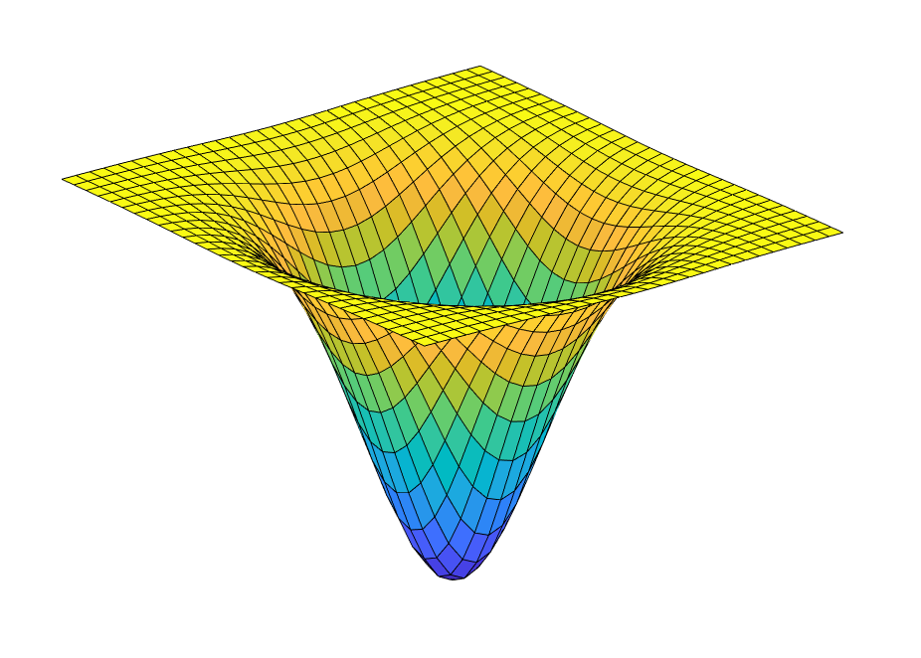
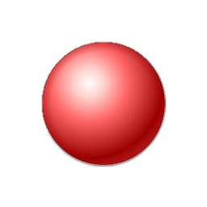
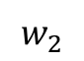
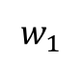
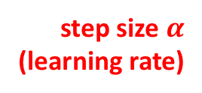
Gradient descent
Network weights are typically trained with gradient descent
visualisation with 2 weights
This involves calculating the derivative of the loss with respect to the parameters, i.e., how much better does a prediction get for a given change in weights?
For linear problems, the error landscape is convex, i.e., there is a single global minimum
$$w_{1}$$
$$w_{2}$$
step size $α$
(learning rate)
Loss
(how bad
is your prediction)
global minimum
(best prediction)
Notes:
Let’s begin with a question. What is really special about human intelligence? What makes us distinctive from that of other highly intelligent species, such as monkeys and birds?
Well, there are lots of anwers to this question, but in this talk I’d like to focus on one of them.

Slide 16
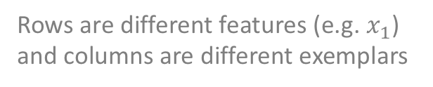
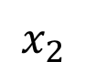
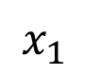
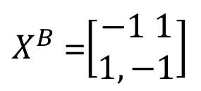

Perceptron fails XOR problem
$X^{A}$ =$\left[\begin{aligned}1,−1 \\ 1, −1\end{aligned}\right]$
$X^{B}$ =$\left[\begin{aligned}−1 1 \\ 1,−1\end{aligned}\right]$
The perceptron can solve linear but not nonlinear classification tasks
This simple problem halted progress in AI research for ~20 years, leading to the first “AI winter”.
Rows are different features (e.g. $x_{1}$) and columns are different exemplars
B
+1
A
$$x_{2}$$
-1
$$x_{1}$$
+1
You can’t draw a straight line that separates A from B!
A
-1
B
Notes:
Let’s begin with a question. What is really special about human intelligence? What makes us distinctive from that of other highly intelligent species, such as monkeys and birds?
Well, there are lots of anwers to this question, but in this talk I’d like to focus on one of them.

Slide 17






Multilayer Perceptron
$$p\left(cat\right)=$$
$$σ\left[Y\right]$$
$$H=$$
$h(X∙W_{1}$)
$$Y=$$
$$H∙W_{2}$$
X
$$W_{1}$$
$$W_{2}$$
decision
input
hidden
output
Information is now transformed over “hidden” layers [here, 1] with a nonlinear activation function $h\left[∙\right]$ at each stage. The most common activation function is a rectified linear unit (ReLU)
ReLU
Negative input set to zero
Positive input unchanged
Encourages sparse inputs
output
input
Notes:
Let’s begin with a question. What is really special about human intelligence? What makes us distinctive from that of other highly intelligent species, such as monkeys and birds?
Well, there are lots of anwers to this question, but in this talk I’d like to focus on one of them.

Slide 18

Multilayer Perceptron
$X^{A}$ =$\left[\begin{aligned}1,−1 \\ 1, −1\end{aligned}\right]$
$X^{B}$ =$\left[\begin{aligned}−1, 1 \\ 1,−1\end{aligned}\right]$
By including multiple layers with nonlinearities, the perceptron can be adapted to solve a wide range of problems
Rows are different features (e.g. $x_{1}$) and columns are different exemplars
B
1
A
$$x_{2}$$
-1
$$x_{1}$$
1
one of many curved lines that can separate A from B
A
-1
B
Notes:
Let’s begin with a question. What is really special about human intelligence? What makes us distinctive from that of other highly intelligent species, such as monkeys and birds?
Well, there are lots of anwers to this question, but in this talk I’d like to focus on one of them.

Slide 19



Gradient descent in deep networks
The challenge with “deep” networks (i.e. those with more than 1 layer) is that they are hard to train.
$$w_{2}$$
Nonlinear problems may have nonconvex solutions. This means that the deep network can get stuck in a local minimum (non-optimal solution)
$$w_{1}$$
Loss
local minimum
global minimum
Notes:
Let’s begin with a question. What is really special about human intelligence? What makes us distinctive from that of other highly intelligent species, such as monkeys and birds?
Well, there are lots of anwers to this question, but in this talk I’d like to focus on one of them.

Slide 20


The visual hierarchy
During the forward sweep of visual processing (~100ms), a signal of dimensionality ~37M in V1 is compressed into a signal of d(~10M)
Notes:
Let’s begin with a question. What is really special about human intelligence? What makes us distinctive from that of other highly intelligent species, such as monkeys and birds?
Well, there are lots of anwers to this question, but in this talk I’d like to focus on one of them.

Slide 21









Hierarchical filtering
decoder
$$y=g(x′′′,θ′′′)$$
$$x^{′}$$
$$x^{′′}$$
$$x^{′′′}$$
cat neuron
$$x′=f(x,θ)$$
$$x′′=f′(x′,θ′)$$
$$x′′′=f′′(x′′,θ′′)$$
$$x$$
$$y$$
encoder
dog neuron
Notes:
Let’s begin with a question. What is really special about human intelligence? What makes us distinctive from that of other highly intelligent species, such as monkeys and birds?
Well, there are lots of anwers to this question, but in this talk I’d like to focus on one of them.

Slide 22

Generalisation
Even if you find the global solution for your training set, that may not be what you want
Notes:
Let’s begin with a question. What is really special about human intelligence? What makes us distinctive from that of other highly intelligent species, such as monkeys and birds?
Well, there are lots of anwers to this question, but in this talk I’d like to focus on one of them.

Slide 23



Failures of generalisation
Network achieves 100% correct performance
training loss
timestep
Imagine you train a network on this training set, and it converges to loss ~0
Now you test on this left out set, but it is at chance! Why….?
Notes:
Let’s begin with a question. What is really special about human intelligence? What makes us distinctive from that of other highly intelligent species, such as monkeys and birds?
Well, there are lots of anwers to this question, but in this talk I’d like to focus on one of them.

Slide 24

Failures of generalisation
effective boundary
cat (test)
dog (test)
cat (train)
ear pointiness
dog (train)
animal size
The network has learned to classify according to a single variable: number of black pixels.
It hasn’t learned anything about cats and dogs at all!
Notes:
Let’s begin with a question. What is really special about human intelligence? What makes us distinctive from that of other highly intelligent species, such as monkeys and birds?
Well, there are lots of anwers to this question, but in this talk I’d like to focus on one of them.

Slide 25

Overfitting and underfitting
poor fit to training
poor fit to test
This model is underfit. It can’t capture the training or test data.
y
good fit to test
This model fits just right. It has some training error, but fits test well
y
good fit to training
poor fit to test
This model is overfit. It captures the training data perfectly, but fails at test
y
x (training)
x (test)
Simple example of overfitting with ground truth $y=x^{2}+𝒩(0,σ)$
Notes:
Let’s begin with a question. What is really special about human intelligence? What makes us distinctive from that of other highly intelligent species, such as monkeys and birds?
Well, there are lots of anwers to this question, but in this talk I’d like to focus on one of them.

Slide 26

Translation invariance
Neurons in IT have large receptive fields, and will respond to objects across the visual field
This is important, because object identity depends only partly on object location.
Fully-connected neural networks fail to show translation invariance
Notes:
Let’s begin with a question. What is really special about human intelligence? What makes us distinctive from that of other highly intelligent species, such as monkeys and birds?
Well, there are lots of anwers to this question, but in this talk I’d like to focus on one of them.

Slide 27


Convolutional neural networks
In the mammalian visual system, processing is convergent and cells have spatially-specific receptive fields
CNNs mimic this by assuming local filters - weights from a small group of input units to a single neuron in the hidden layer
Each local filter (with fixed weights) is convolved with multiple overlapping positions on the input map, so that the responds at hidden unit {x,y} is now n deep, where n is the number of positions
CNNs combine local filtering and global weight sharing
Krizhevsky et al 2012
Notes:
Let’s begin with a question. What is really special about human intelligence? What makes us distinctive from that of other highly intelligent species, such as monkeys and birds?
Well, there are lots of anwers to this question, but in this talk I’d like to focus on one of them.

Slide 28






Convolutional Neural Networks
$$b_{i}=\frac{a_{i}}{{\left(k+α∙\sum{a_{j}^{2}}\right)}^{β}}$$
divisive normalisation
dimensionality reduction
layerwise depth
convolution
local receptivity
Krizhevsky et al 2012
Notes:
Let’s begin with a question. What is really special about human intelligence? What makes us distinctive from that of other highly intelligent species, such as monkeys and birds?
Well, there are lots of anwers to this question, but in this talk I’d like to focus on one of them.

Slide 29




Imagenet
Over 6 million labelled images
Krizhevsky et al 2012
Notes:
Let’s begin with a question. What is really special about human intelligence? What makes us distinctive from that of other highly intelligent species, such as monkeys and birds?
Well, there are lots of anwers to this question, but in this talk I’d like to focus on one of them.

Slide 30

Neural-like phenomena
Filters learned by first layer of CNN resemble coding properties of V1 cells, i.e. Gabor filters with variable orientation and spatial frequency
Notes:
Fast forward to 1997.
IBM’s Deep Blue became the world’s best chess player, beating then world champion Gary Kasparov.
Kasparov didn’t like being beaten, and he promptly accused the machine of cheating. But it wasn’t cheating. Deep Blue was at the time running on one of the world’s most powerful supercomputers. Today, thanks to advances in computing power, the world’s grandmasters can be easily beaten by chess software running on your smartphone.

Slide 31

Correspondence with IT signals
Strong overlap in responses of IT neurons and network units to different classes of stimuli
Yamins et al 2014
Notes:
Let’s begin with a question. What is really special about human intelligence? What makes us distinctive from that of other highly intelligent species, such as monkeys and birds?
Well, there are lots of anwers to this question, but in this talk I’d like to focus on one of them.

